Slide 2
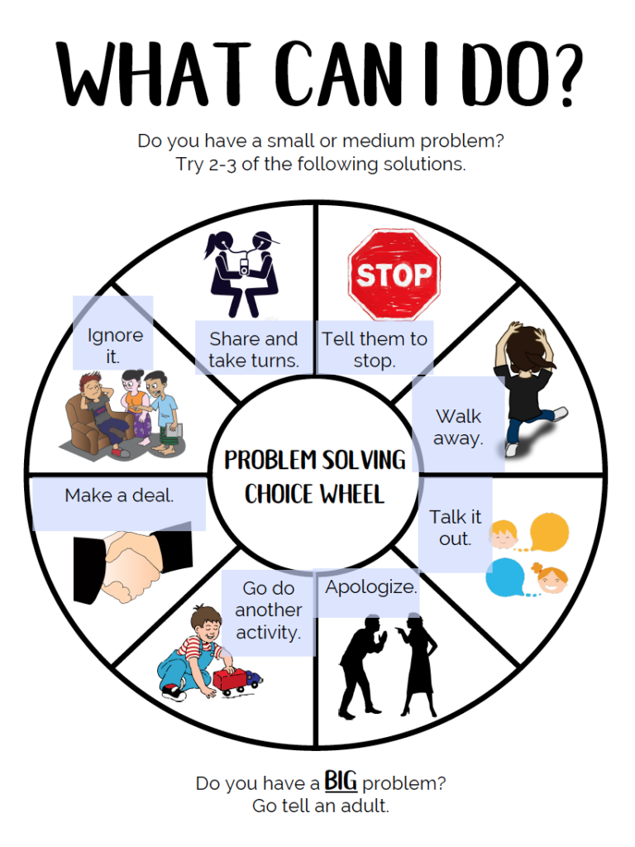

Slide 3
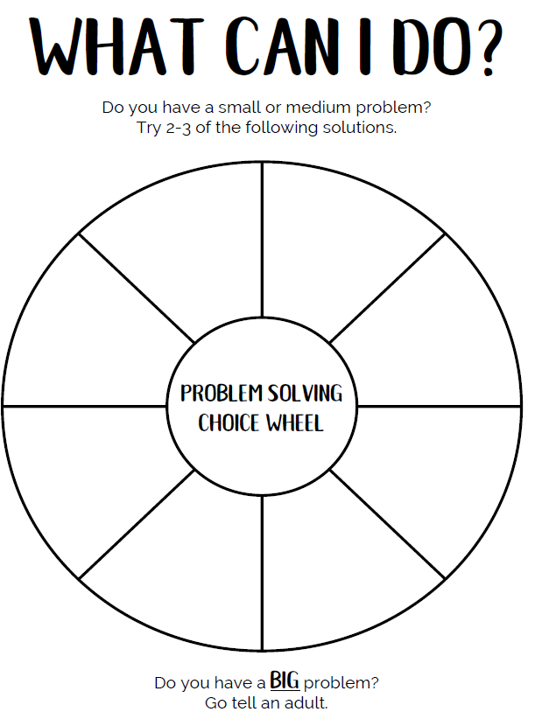
What are some of the choices
you can put in your problem-
solving wheel?
Think of some things we have
already discussed. Can you
think of anything else you can
add?

Slide 4
Use your WITS and problem solving
wheel to help you decide what you can
do to resolve conflicts.

Slide 5
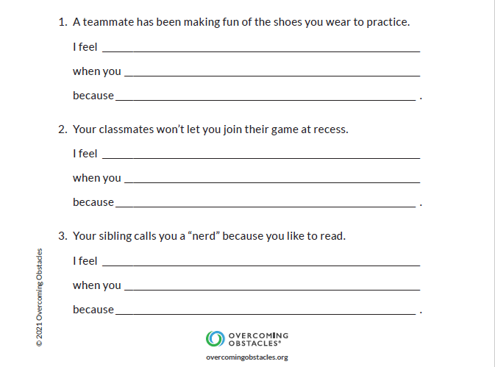
Grades 3-5
It’s helpful to tell someone how their behaviour
is making you feel. Sometimes that is not easy to do!
Practice by completing the “I Statements” that go
with each scenario.

Slide 6
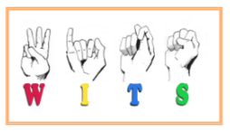
WITS library stories to choose from

Slide 7
Choose a story to listen to. Which WITS are the characters using?

